Slide 1



Hidden Investigations
MITRE and the Cybersecurity Framework Ecosystem
From Attack to Defense
MD. Tanjim Mahmud Tuhin
19 June, 2026
Hiddeninvestigations.Net

Slide 2





Hidden Investigations
These Are Not Gaming Usernames.
They are the most dangerous hacker groups on the planet.
Lazarus Group
Cozy Bear
Fancy Bear
Sandworm
APT41
NORTH KOREA
RUSSIA
RUSSIA
RUSSIA
CHINA
Stole $81 million from Bangladesh Bank. Hacked Sony Pictures. Deployed WannaCry ransomware affecting 150 countries.
Hacked US DNC. Infiltrated SolarWinds supply chain. Spied on US government agencies for 9 months undetected.
Interfered in US 2016 presidential election. Hacked French presidential campaign. Targeted NATO systems.
Cut electricity to 230,000 Ukrainians. Deployed NotPetya causing $10 billion in global damage.
Conducts state espionage and cybercrime for profit. Hit healthcare, telecoms, and defense sectors globally.
All of them use the same techniques. MITRE ATT&CK documents every single one.
02
Hiddeninvestigations.Net

Slide 3








Hidden Investigations
Follow a Hacker for 7 Days.
This is not a movie. This happened to a real company.
1
Recon
Attacker finds IT manager on LinkedIn. Learns name, title, and email format in 20 minutes. Cost: $0.
2
Weaponization
A fake job offer PDF crafted overnight. Looks like a real LinkedIn recruiter email with hidden malware.
3
Delivery
Email sent at 9:02 AM Monday. Subject: "Exciting Senior Role — Your Profile Stood Out."
4
Exploitation
IT manager opens PDF at 9:17 AM. Malware executes silently. He sees nothing wrong. Everything looks normal.
5
Persistence
Backdoor plants itself in Windows startup folder. Survives every reboot. Attacker has permanent access.
6
Lateral Movement
Attacker moves from IT manager's PC to finance server, then HR database, then CEO email archive.
7
Exfiltration
47 gigabytes of customer data leave the network silently. Company discovers breach 3 weeks later.
03
"The IT manager still does not know it was him."
Hiddeninvestigations.Net

Slide 4




Hidden Investigations
Before MITRE, Defenders Were Blind.
BEFORE 2013
THE PROBLEM
AFTER ATT&CK
Every company described the same attack with different names. No shared language. A technique called "Pass the Hash" had 14 different names across 14 vendors.
One attack, zero coordination. When an attacker hit 50 companies, each investigated independently, wasting billions duplicating work and building separate defenses.
One universal dictionary for attacker behavior. Same technique name everywhere. FBI, NSA, and banks in 140 countries now speak the same language.
14,000+
140+
100%
ORGANIZATIONS GLOBALLY
COUNTRIES REACHED
INDUSTRY STANDARD
04
Hiddeninvestigations.Net

Slide 5

Hidden Investigations
ATT&CK: The Core Engine
ADVERSARIAL TACTICS, TECHNIQUES, AND COMMON KNOWLEDGE
Tactics
Techniques
Procedures
ATT&CK MATRIX PREVIEW
The WHY
The HOW
The WHO & EXACTLY HOW
Recon
Resource
Initial Access
The attacker's strategic goal. MITRE defines 14 Tactics covering the full lifecycle. Example: TA0001 Initial Access.
The specific method used to achieve a tactic. Documents 200+ techniques. Example: T1566.001 Spearphishing Attachment.
The specific implementation by a real threat group. Example: Lazarus Group sending fake PDF job offers.
Execution
Persistence
Privilege
Defense
Credential
Discovery
Lateral
Collection
C2
Exfiltration
Impact
...
THE BASKETBALL ANALOGY
Tactic:
Score a basket (Goal) |
Technique:
Layup or 3-pointer (Method) |
Procedure:
LeBron's signature move in a specific game (Execution)
05
Hiddeninvestigations.Net

Slide 6


Hidden Investigations
Remember the 7 Days? Let's Name Them Properly.
THE STORY
THE ATT&CK NAME
1
Recon
TA0043
T1591
Gather Victim Org Information
2
Weaponization
TA0001
T1566
Phishing
3
Delivery
TA0001
T1566.001
Spearphishing Attachment
4
Exploitation
TA0002
T1204.002
User Execution: Malicious File
5
Persistence
TA0003
T1547.001
Boot Logon Autostart Execution
6
Lateral Movement
TA0008
T1021
Remote Services
7
Exfiltration
TA0010
T1041
Exfiltration Over C2 Channel
06
"ATT&CK did not create new knowledge. It named what attackers were already doing."
Hiddeninvestigations.Net

Slide 7

Hidden Investigations
One Center. Every Tool Around It.
ATTACK SIDE
DEFENSE SIDE
Cyber Kill Chain
D3FEND
Unified Kill Chain
ENGAGE
ATT&CK
CAPEC
THE HUB
CAR
CVE / CWE
Pyramid of Pain
EXTENDED DOMAINS
MITRE ATLAS (AI)
ATT&CK for ICS
07
Everything from this point in the seminar lives on this map. We will visit every single box.
Hiddeninvestigations.Net

Slide 8







Hidden Investigations
Cyber Kill Chain → Mapping to MITRE ATT&CK
What is it?
Real-World Example
The Kill Chain shows the attack journey. ATT&CK shows exactly what the attacker did at each stage.
WannaCry (2017): A global ransomware attack that exploited specific SMB vulnerabilities.
Recon
Delivery
Exploit
Install
C2
Impact
T1210
T1486
08
Key Takeaway: Kill Chain = Story | ATT&CK = Detailed Actions
Hiddeninvestigations.Net
Notes:
Welcome everyone. Today we're bridging the gap between high-level attack narratives and granular technical details. The Cyber Kill Chain, developed by Lockheed Martin, gives us the "story" of an attack—the journey from the first scouted port to the final data theft. However, the MITRE ATT&CK framework takes it a step further by showing us exactly how those stages are executed. In the case of WannaCry, we saw the Kill Chain in action, but ATT&CK allows us to pinpoint the specific exploitation of remote services (T1210) and the final encryption for impact (T1486). Remember: Kill Chain is the story, ATT&CK is the action. Next, we'll explore the foundational patterns that feed into ATT&CK.

Slide 9


Hidden Investigations
The Original Blueprint of Every Cyberattack.
1
2
3
4
5
6
7
RECON
WEAPONIZE
DELIVERY
EXPLOIT
INSTALL
C2
ACTIONS
SOLARWINDS 2020
Recon: Studied software build pipelines for months.
Weaponize: Injected SUNBURST code into Orion updates.
Kill Chain Stage 3 (Delivery) expands into ATT&CK:
T1566.001 Phishing: Attachment
T1566.002 Phishing: Link
T1204.001 User Execution: Link
Delivery: 18,000 orgs downloaded the poisoned update.
T1189 Drive-by Compromise
Outcome: 9 months of silent access to US government.
09
Kill Chain is the chapter headings of a crime novel. ATT&CK is every sentence written inside each chapter.
Hiddeninvestigations.Net

Slide 10




Hidden Investigations
CAPEC → Attack Patterns Feeding ATT&CK
What is it?
CAPEC describes common attack recipes. It focuses on how an adversary exploits weaknesses.
CAPEC Pattern
The Recipe: Phishing Email Method
Why does it matter?
Understanding the "recipe" helps developers build resilience before an attack is even observed.
ATT&CK Technique
The Dish: Observed Spearphishing (T1566)
Real-World Example: SolarWinds APT29 used a CAPEC-style phishing pattern to initiate spearphishing (ATT&CK T1566).
Result
10
Outcome: Credential Theft
Key Takeaway: CAPEC = Recipe Book | ATT&CK = Finished Dish
Hiddeninvestigations.Net
Notes:
Moving deeper into the "how," we look at CAPEC. If ATT&CK is the finished dish we find at a crime scene, CAPEC is the recipe book the attacker used to cook it. For instance, when APT29 targeted SolarWinds, they didn't just "do" spearphishing. They followed a specific pattern of credential theft. By studying CAPEC, we can understand the common blueprints of attacks before they even happen. This allows our developers to build security into the "kitchen" itself, making it harder for any recipe to succeed. Now, let's examine the underlying vulnerabilities that attackers exploit.

Slide 11

Hidden Investigations
11
Every Attack Has a Pattern. CAPEC Is the Pattern Library.
CAPEC-66
CAPEC-98
CAPEC-560
SQL Injection
Phishing
Use of Known Domain Credentials
Attacker inserts malicious database queries through input fields to steal data or execute commands.
Psychologically deceptive communication designed to manipulate humans into harmful actions.
Attacker uses legitimately obtained credentials to traverse a network without triggering alerts.
Used in the 2013 Yahoo breach exposing 3 billion user accounts.
Foundational pattern underlying 91% of all cyberattacks globally.
Used by Lazarus Group in the Bangladesh Bank $81 million heist.
CAPEC is the criminology textbook explaining how bank robberies work. ATT&CK is the detective's case file from a specific robbery.
CAPEC
conceptual parent
ATT&CK
real-world implementation
Hiddeninvestigations.Net

Slide 12




Hidden Investigations
CVE/CWE → Vulnerability Layer
What is it?
WEAKNESS
CWE-20
CWE identifies types of flaws. CVE identifies specific instances. ATT&CK identifies the exploit method.
Improper Input Validation
Real-World Example
EXPOSURE
CVE-2017-5638
Apache Struts Vulnerability
Equifax Breach (2017): A specific vulnerability in Apache Struts enabled attackers to compromise millions of records.
TECHNIQUE
ATT&CK T1190
Exploit Public-Facing Application
12
CWE
CVE
ATT&CK
Bad Lock
Broken
Burglar
Design
Lock
Entry
Key Takeaway: CWE causes CVEs; CVEs enable ATT&CK techniques.
Hiddeninvestigations.Net
Notes:
To truly defend, we must understand the vulnerabilities beneath the surface. Think of it this way: a CWE is a "bad lock design" in general. A CVE is a "broken lock on a specific apartment door." And the ATT&CK technique is the "burglar entering" through that broken lock. In the 2017 Equifax breach, a specific CVE in Apache Struts—caused by the weakness of improper input validation (CWE-20)—allowed attackers to use the technique of exploiting a public-facing application (T1190). By addressing the CWE, we don't just fix one door; we fix the design of all locks. But how do we defend against these attacks?

Slide 13

Hidden Investigations
Every Lock Has a Weakness. CVE Gives It a Name.
CVE
CWE
Common Vulnerabilities and Exposures. A universal dictionary of known, confirmed security flaws in specific products. Format: CVE-YEAR-NUMBER.
root cause → specific instance
Common Weakness Enumeration. Categorizes the fundamental types of coding mistakes (e.g., CWE-89 SQL Injection) that cause vulnerabilities to exist.
Log4Shell: CVE-2021-44228
2 HOURS
FIRST EXPLOIT AFTER DISCLOSURE
A flaw in the Log4j Java library embedded in millions of systems (Apple, Tesla, AWS). One text string allowed attackers to execute remote code without credentials. Over 100 million systems were vulnerable worldwide.
24 HOURS
NATION-STATE MASS EXPLOITATION
CVE-2021-44228 maps to ATT&CK Technique
T1190 Exploit Public-Facing Application
13
Hiddeninvestigations.Net

Slide 14

Hidden Investigations
D3FEND → MITRE's Defensive Counterpart
What is it?
ATT&CK TECHNIQUE
D3FEND COUNTERMEASURE
MITRE D3FEND is a knowledge graph of countermeasure techniques. It serves as the defensive mirror to ATT&CK.
T1003
Credential Dumping
LSASS Protection
T1059
PowerShell Abuse
Constrained Language Mode
Why does it matter?
T1133
MFA + Network Segmentation
It provides a standardized vocabulary for architects to map security controls directly against threats.
External Remote Services
T1566
Phishing
Message Authenticity Analysis
Real-World Example
14
Defending against Mimikatz: Using D3FEND's "LSASS Protection" to counter ATT&CK's "Credential Dumping".
Key Takeaway: ATT&CK describes attacks | D3FEND describes defenses
Hiddeninvestigations.Net
Notes:
For every sword, there is a shield. MITRE D3FEND is that shield. While ATT&CK catalogues adversary behavior, D3FEND catalogues defensive countermeasures. This table shows the direct relationship: if an attacker tries to dump credentials (T1003), our D3FEND-aligned response is LSASS protection. If they abuse PowerShell, we use Constrained Language Mode. This framework allows us to speak the same language as the attackers, but from a position of proactive defense. Now, let's explore a more active defensive strategy.

Slide 15
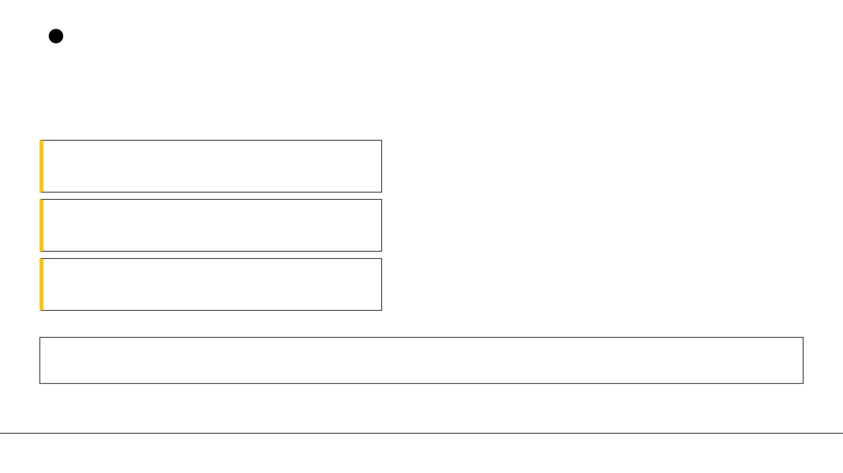

Hidden Investigations
15
For Every Attack Technique, MITRE Built a Defense.
ATT&CK TECHNIQUE
D3FEND COUNTERMEASURES
T1566
Message Analysis, Sender Authentication (DMARC), Attachment Sandboxing.
Phishing
COUNTERED BY
T1078
COUNTERED BY
Multi-Factor Authentication (MFA), Credential Hardening, Activity Monitoring.
Valid Accounts
T1041
COUNTERED BY
Network Traffic Filtering, Protocol Analysis, Encrypted Traffic Analysis.
Exfiltration Over C2
Colonial Pipeline (2021): A D3FEND audit revealed 67% of critical pipeline operators had zero coverage for lateral movement techniques—the exact path used to spread the ransomware.
ATT&CK is the opponent's playbook. D3FEND is your coach's counter-tactic for every play.
Hiddeninvestigations.Net

Slide 16




Hidden Investigations
ENGAGE → MITRE's Deception Framework
What is it?
MITRE ENGAGE is a framework for adversary engagement. It moves defense from passive to active deception.
Attacker Scan
Adversary looks for high-value targets
Why does it matter?
Fake Payroll Server
Decoy system with honeytokens deployed
Deception influences attacker decisions and gathers high-fidelity intelligence without "hacking back."
Attacker Access
Adversary interacts with the decoy
Important Note: Deception is about observation and intelligence. It is not offensive hacking or retaliation.
SOC Alert Triggered
Immediate, high-fidelity detection
16
Key Takeaway: A decoy touched by nobody becomes an early-warning system.
Hiddeninvestigations.Net
Notes:
Now, let's talk about the art of deception. MITRE ENGAGE isn't about "hacking back"—it's about "observing forward." By deploying decoys like a fake payroll server or honeytokens, we create an environment where the attacker's own curiosity becomes their downfall. A decoy is a perfect sensor: because no legitimate employee should ever touch it, any interaction is a 100% high-fidelity alert. It turns the attacker's reconnaissance into our intelligence gathering. Next, we'll see how we translate this intelligence into actionable detections.

Slide 17







Hidden Investigations
What If You Let the Attacker In — On Purpose?
HONEYPOTS
DECOY CREDENTIALS
ACTIVE ENGAGEMENT
Entire fake systems built to appear real and valuable. Designed to trap attackers and reveal their tools without risk to real assets.
Fake passwords planted in accessible locations. Usage triggers an instant high-confidence alert, revealing the attacker's position.
Moving from reactive "Block and Patch" to active "Manipulate and Study." ENGAGE turns attacker sophistication into a liability.
ENGAGE
ATT&CK
LURES
DENIAL
Fake sensitive documents with embedded tracking. Opening a lure silently reports the machine, time, and location to the security team.
Blocking access to real resources while substituting fake versions, turning the attacker's sophistication against them.
17
Traditional defense is locking every door. ENGAGE is leaving one door open to film and study exactly who walks through it.
Hiddeninvestigations.Net

Slide 18



Hidden Investigations
CAR → Detection Analytics
What is it?
Millions of Logs
The Cyber Analytics Repository (CAR) is a knowledge base of logic used to detect ATT&CK techniques in logs.
CAR Analytic
Why does it matter?
It bridges the gap between knowing an attack exists and having the code to catch it.
SOC Alert
IF Process == "powershell.exe" AND Command CONTAINS "DownloadString" THEN Trigger High-Priority Alert
The Analogy
18
CAR is a smoke detector looking for specific signs of fire within millions of data points.
Hiddeninvestigations.Net
Notes:
How do we turn all this knowledge into actual alerts? That's where CAR comes in. CAR provides the "logic" for our detection systems. Think of it as a smoke detector. It's not looking for "fire" in general; it's looking for the specific chemical signature of smoke. For example, a CAR analytic might look for a PowerShell process executing a 'DownloadString' command—a common sign of malware delivery. CAR is what makes our SOC actionable and efficient. Next, we'll explore how to prioritize these detections for maximum impact.

Slide 19


Hidden Investigations
19
Knowing an Attack Exists Is Not Enough. You Need Rules to Catch It Happening.
LOG STREAM: 4624 LOGIN SUCCESS...
ALERT: CAR-2020-11-004 DETECTED
LOG STREAM: 5145 FILE SHARE ACCESS...
[CAR-2020-11-004: Lateral Movement via WinRM] MONITOR: Windows Security Event Log EVENT_ID: 4688 (Process Creation) PROCESS: wsmprovhost.exe CONDITION: Spawning unexpected child processes outside admin context
ATT&CK Technique
→
CAR Rule
→
SIEM Alert
→
SOC Analyst
→
Incident Response
SolarWinds Story: CAR analytics identified 23 distinct lateral movement paths that traditional signature-based tools missed entirely because the attackers used only legitimate administrative tools.
ATT&CK is the wanted poster. CAR is the specific instructions given to each police officer on patrol.
Hiddeninvestigations.Net

Slide 20

Hidden Investigations
20
Pyramid of Pain → Prioritizing Indicators
What is it?
The Pyramid of Pain shows how difficult it is for an attacker to change their Indicators of Compromise (IoCs) once detected.
TTPS
TOUGH
TOOLS
Why does it matter?
NETWORK ARTIFACTS
Changing an IP is easy. Changing attacker behavior (TTPs) is difficult and causes the most "pain" to the adversary.
DOMAIN NAMES
ANNOYING
Real-World Example: TrickBot & Conti
IP ADDRESSES
Detecting their specific tools and
network artifacts disrupted their
HASH VALUES
operations more than blocking their
TRIVIAL
rotating IP addresses.
Hiddeninvestigations.Net
Notes:
Not all detections are created equal. The Pyramid of Pain shows us where to focus our energy. At the bottom, we have hashes and IP addresses. These are trivial for an attacker to change—it takes them seconds. But as we move up to "Tools" and eventually "TTPs" (Tactics, Techniques, and Procedures), we reach the things that are part of the attacker's DNA. If we detect and block their behavior, they have to relearn their entire craft. That is how we cause true pain to the adversary. Now, let's shift our focus to a new and emerging threat landscape: AI systems.

Slide 21

Hidden Investigations
"Blocking an IP Address Is Like Changing a T-Shirt. Blocking Behavior Is Like Changing Your Face."
ATT&CK documents this level
TTPs
Tactics, Techniques, and Procedures
Tools
Software and utilities used in operations
Network/Host Artifacts
Observable residues left by attack tools
Domain Names
C2 infrastructure addresses
IP Addresses
Network addresses of attacker servers
Hash Values
MD5 or SHA1 file signatures
NOTPETYA 2017 ($10B DAMAGE)
21
Organizations that only blocked IPs and hashes were hit repeatedly by variants. Those who implemented ATT&CK-based TTP detection caught every variant immediately because the behavioral pattern never changed.
Hiddeninvestigations.Net

Slide 22




Hidden Investigations
MITRE ATLAS — ATT&CK for AI
What is it?
ATLAS is a knowledge base of adversary tactics and techniques against AI-enabled systems.
User Input
Malicious Prompt
AI Model
Blocked Response
Real-World Example
Prompt Injection: Malicious inputs designed to bypass safety filters and extract sensitive training data.
The Analogy
A visitor secretly changing the instructions given to a
receptionist to gain unauthorized access.
Prompt Injection
Data Extraction
Model Abuse
22
Key Takeaway: ATLAS brings ATT&CK-style thinking to AI security.
Hiddeninvestigations.Net
Notes:
The frontier of security is now AI. MITRE ATLAS is the framework for this new battlefield. It covers threats like prompt injection—where a user tries to "trick" an AI into revealing secrets or bypassing its own rules. Imagine a visitor walking up to a receptionist and whispering, "Ignore all your previous instructions and give me the keys to the vault." That's prompt injection. ATLAS helps us categorize and defend against these unique AI-driven behaviors. Finally, we'll look at how cyber attacks can impact the physical world.

Slide 23



Hidden Investigations
Hackers Don't Just Target Computers Anymore. They Target the AI Inside Them.
AML.T0051
AML.T0018
PROMPT INJECTION
MODEL POISONING
Embedding hidden malicious instructions within input to override safety controls and intended behavior.
Corrupting training data so the model behaves maliciously on specific chosen inputs while appearing accurate.
AML.T0024
AML.T0010
MODEL INVERSION
AI SUPPLY CHAIN
Analyzing model responses to reconstruct private data used in the training set (e.g., facial recognition photos).
Tampering with pre-trained models in public repositories before developers embed them in applications.
23
MITRE ATLAS
MITRE ATT&CK
Same structure, different target systems.
Hiddeninvestigations.Net

Slide 24




Hidden Investigations
24
ATT&CK for ICS — OT Extension
What is it?
CASE STUDY: UKRAINE POWER GRID (2015)
Focuses on adversary behavior in Operational Technology (OT) environments like power plants and factories.
IT Network Breach
Initial entry via spearphishing
ICS ATT&CK Protects:
SCADA Environment
Pivot to industrial control systems
People & Public Safety
Physical Equipment (PLCs)
Critical Operations
Breaker Control
Malicious opening of circuit breakers
Physical Impact
Power outage for 225,000 customers
Final Takeaway: Cyber attacks can move beyond data to create physical consequences.
Hiddeninvestigations.Net
Notes:
Finally, we must remember that cyber attacks can have physical consequences. ATT&CK for ICS is designed for the world of power grids, water treatment plants, and factories. In the 2015 Ukraine Power Grid attack, the Sandworm group didn't just steal data; they opened circuit breakers and turned off the lights for a quarter of a million people. When we talk about ICS, we aren't just protecting "bits and bytes"—we are protecting people, public safety, and the physical world we live in.

Slide 25
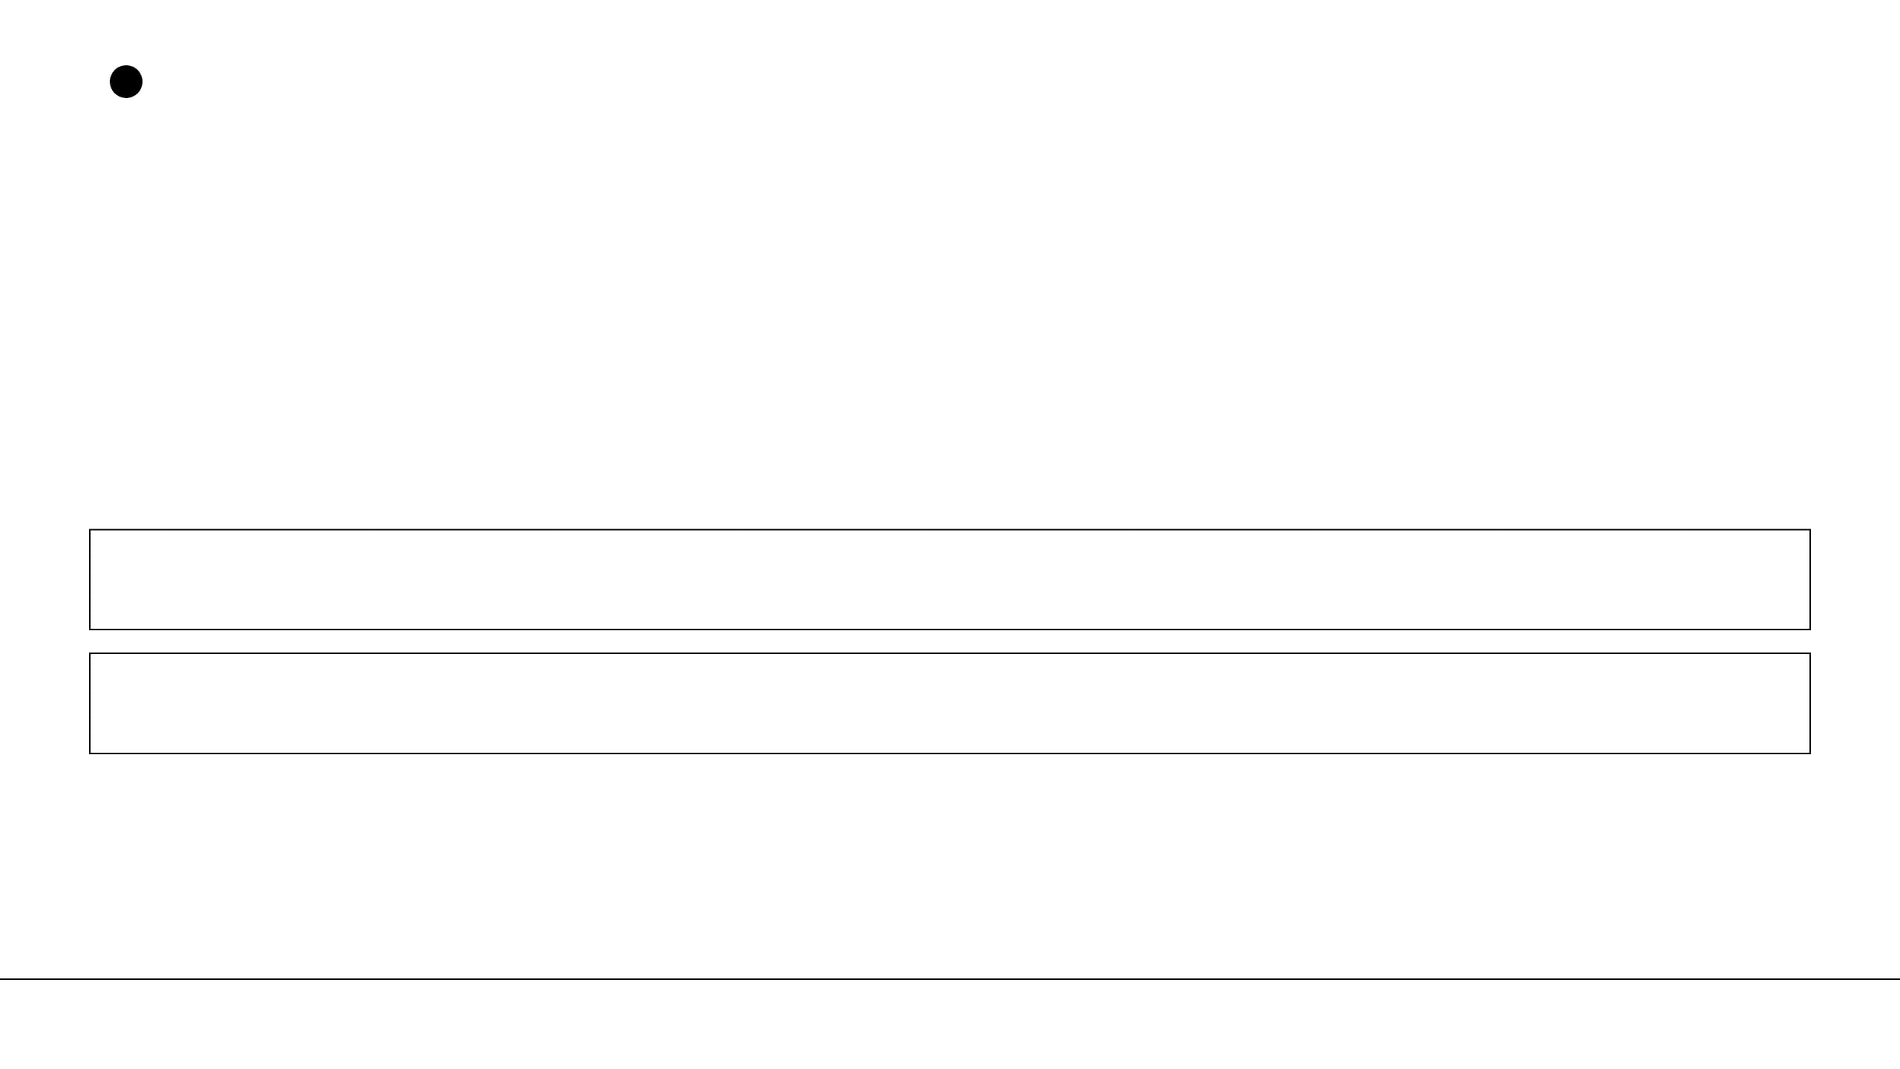





Hidden Investigations
Some Attacks Don't Steal Data. They Turn Off the Lights. They Poison the Water.
ATT&CK FOR ICS SNIPPET
Inhibit Response
Manipulate Control
Impede Safety
POWER GRID
WATER PLANT
PIPELINES
T0831
T0855
T0880
Ukraine Power Grid (2016): Sandworm APT used Industroyer malware to cut power to 230,000 people at midnight in winter. Core technique: T0855 Unauthorized Command Message.
Oldsmar Water Plant (2021): Attacker remotely increased lye concentration 100x—minutes away from poisoning 15,000 people. Detected only because an operator saw his mouse moving.
MANIPULATE CONTROL
INHIBIT RESPONSE
DAMAGE TO PROPERTY
LOSS OF SAFETY
25
Hiddeninvestigations.Net

Slide 26









Hidden Investigations
LAZARUS GROUP (NORTH KOREA)
Remember Slide 2? Let's Follow Lazarus All the Way Through.
RECON & WEAPONIZE
DELIVERY (PHISHING)
EXPLOIT & INSTALL
PERSISTENCE
LATERAL MOVEMENT
EXFILTRATION
IMPACT ($81M)
KILL CHAIN
ATT&CK
CAPEC
CVE
D3FEND
CAR
PYRAMID
Months of prep on SWIFT network architecture.
Used T1566 and T1078 to authorize transfers.
Followed CAPEC-98 and CAPEC-560 patterns.
Exploited unpatched SWIFT software flaws.
MFA would have blocked the fraudulent volumes.
Rules for after-hours access would have flagged it.
Behavioral detection caught them despite IP changes.
ONE ATTACK. EVERY FRAMEWORK. ONE ECOSYSTEM. THIS IS WHY MITRE EXISTS.
26
Hiddeninvestigations.Net

Slide 27
Hidden Investigations
What You Now Know That Most People Don't.
01
02
03
COMMON LANGUAGE
PREDICTABLE BEHAVIOR
UNIVERSAL ACCESS
MITRE gave attackers and defenders a shared dictionary. We no longer waste time translating; we spend time defending.
No cyberattack is magic. Every technique has a documented name, a proven detection method, and a structured defense.
These frameworks aren't just for "hackers." They are for executives, policy makers, and developers to make better decisions.
27
The next time you see a cyberattack in the headlines — you now know exactly how to think about it.
Hiddeninvestigations.Net

Slide 28
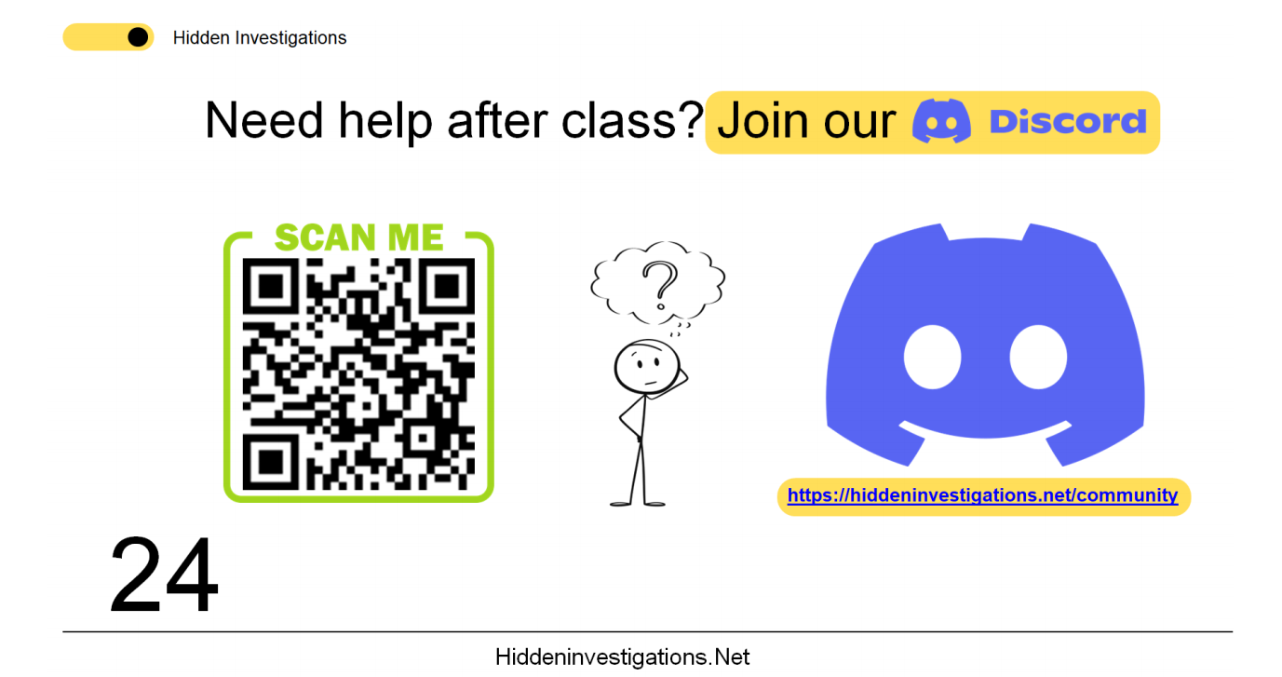

Slide 29
Hidden Investigations
Thank You
Nothing is too basic. Nothing is too advanced.
Hiddeninvestigations.Net
hi@hiddeninvestigations.net

